Slide 1
Face Recognition at Mini Server

Slide 2
Background
This is part of the demo of IoT.
Face recognition can be done locally at the mini server at the vicinity of sensor before transferring back to the main server/processor.
Hence, this project is aimed to perform face recognition at the local mini server.

Slide 3
Input/Output
The input is the video stream captured by cameras connected to the IoT.
Opencv2 library is used to capture the video stream and sample the image. This allowed the captured image to be transformed into Numpy array.
The final output is the face recognition result which can be transmitted to the master control.

Slide 4
Target and Application Environment
In this context, few human faces will be selected as targeted faces in this project.
Targeted faces will be captured using same camera that will be used in the testing environment.
The testing location is in an exhibition hall which has a bright lighting. There is human flow and no restriction of entry. However, camera is installed at fixed spot.

Slide 5
Complication
Multiple faces can be taken into an image frame at the same time.
Lighting can be different in between testing ground and training ground. Bright lighting (which is mainly yellow lighting that has significant R and G component) can reduce the contrast in between face and surrounding environment. Face area which is not exposed to the light may not be recognized.
Though targeted face is known, the application ground is an open space that allow free movement. Hence, accuracy varies between individual visitor.
For the targeted face, not all facial expression/hair style can be captured. Spectacle effect can also be extra factor to the recognition accuracy.

Slide 6
Proposed Flow
1. Image capturing
2. Training face recognition
3. Testing/Use the model in real time face recognition

Slide 7
Environment
Using Anaconda to install all necessary packages.
Use yml file to get the list of packages.
Create the environment based on the yml file if packages are missing.

Slide 8
Image Capturing
Using opencv2 in image capturing from video stream.
Haar Wavelet face cascade method (standard function used in opencv2) is used to capture the human face pixels.
Use MTCNN (in courtesy of MIT) to refine the face area captured using Haar Wavelet.
Disallow image capturing if MTCNN cannot capture eye/nose/mouth location.

Slide 9
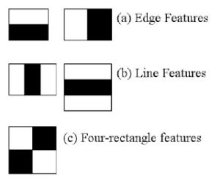
Haar Face Cascade
Haar Cascade [1] has 4 stages:
Haar Feature Selection
Creating Integral Images
Adaboost Training
Cascading Classifiers
In feature selection, it actually gets Haar features such as edge features and line features. Although not exactly a resultant of Haar Wavelet, Haar features can be calculated thru integral images method that is implemented in the opencv.
Notes:
[1] Rapid Object Detection using a Boosted Cascade of Simple Features , 2001.

Slide 10
Haar Face Cascade
For each features, we will try to find out what is the best threshold that can predict whether the trained images are human face or not.
However, not all features obtained thru integral images are useful. The model applied on the features are considered to be weak classfier as each of them only holds information at certain spatial region of the whole image.
Adaboost classfiers are actually an ensemble classfier of the weak classfier that applied on each Haar feature. Boosting allows stronger feature classifer to be ensembled as a weighted averaged strong classfier.
Finally, the Adaboost classfiers are cascaded in stages. As a result, image area that fits the face features the most are highlighted.

Slide 11
MTCNN – Face Encoding
MTCNN [2] or Multi-Task Cascaded Convolutional Neural Network is used for face landmark detection and face boundary detection.
MTCNN has 3 stages of neural networks.
At 1st stage, the input image is scaled down multiple times to build an image pyramid. Each scaled version of image pyramid is passed through it’s convolutional neural network (CNN) that knowns as Proposal Network (P-Net).
P-Net is using 12x12 kernel with strides 2 to process input image. P-Net will produce the bounding box for each 12x12 kernel. The resultant bounding boxes that had higher probability (generated by P-Net as face classification result) will be parsed to next stage.
Notes:
[2] Zhang, K., Zhang, Z., Li, Z., and Qiao, Y. (2016). Joint face detection and alignment using multitask cascaded convolutional networks. IEEE Signal Processing Letters, 23(10):1499–1503.
Explaination: https://towardsdatascience.com/how-does-a-face-detection-program-work-using-neural-networks-17896df8e6ff

Slide 12
MTCNN – Face Encoding
At 2nd Stage, all the candidate bounded images from stage 1 are fed into CNN that known as Refine Network or R-Net.
2nd stage is using 24x24 kernel on the inputs.
At each 24x24 kernel output, CNN process another set of bounding boxes and probabilities. So, we are able to reject some of the candidate images from stage 1. This is how the 2nd stage is refining 1st stage result.

Slide 13
MTCNN – Face Encoding
At stage 3rd stage, 48x48 kernel is applied on 2nd stage candidate bounded image.
While producing new bounding coordinates and probability of fitting the face feature, it also compute the face landmark coordinate.
5 face landmark points (left/right eye, left/right mouth, nose tip) are computed. The 5-points are obtained though minimization of Euclidean loss.
Best bounding coordinate and 5 face landmark coordinates are selected. Hence, 3rd stage is known as O-Network or output network.

Slide 14
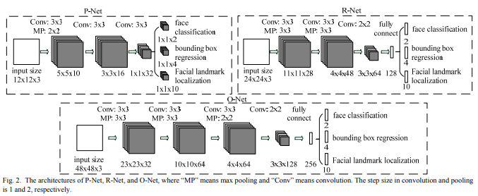
MTCNN

Slide 15
MTCNN – Face Alignment
Opencv Haar Face Cascade is based on Haar features and hence it is subjected to error where features of other object fits the threshold given.
MTCNN can identify the face landmark (eye/mouth/nose) of an image. By input Haar Cascade image into MTCNN, we can reject the image captured from Haar Cascade from further processing if face landmark coordinates is not returned from MTCNN.
In this project, the face image pixels within the MTCNN boundary will be taken (MTCNN outputs boundary coordinate instead of image).
These identified face image pixels will be resized into (160,160). The pixels which are too far away from left eye/right eye will be cropped. Forehead and pixels under mouth will also be cropped. This will reduce the noise due to varying hair style and background.
Final image will be resized again to (160,160) before input to pre-trained Facenet neural network.

Slide 16
Facenet – Face Encoding
Facenet [3] is a deep neural network which encode the image into 128 byte code.
Facenet weights are pre-trained based on ~50 million faces.
Hence, Facenet is used to encode images into 128 byte code in this project based on the pretrained network weights.
Training of 50 million faces requires long training time. Application of Facenet saves the training time while allow the faces to be encoded without accessing to massive dataset.
Notes:
[3] FaceNet: A Unified Embedding for Face Recognition and Clustering
Florian Schroff, Dmitry Kalenichenko, James Philbin
(Submitted on 12 Mar 2015 (v1), last revised 17 Jun 2015 (this version, v3))

Slide 17
Facenet
Facenet is using shared layers to compute triplet loss of anchor, positive and negative images.
Anchor image (specific person image) should have less distance to the positive image (other image that is labelled to the same person) as compared to distance to the negative images (other images that labelled to other persons).
Triplet loss is then total squared distance of anchor image to positive image minus total squared distance of anchor image to negative image.
As a result, SGD training using ADAGRAD boosting is using to minimized the triplet loss.

Slide 18
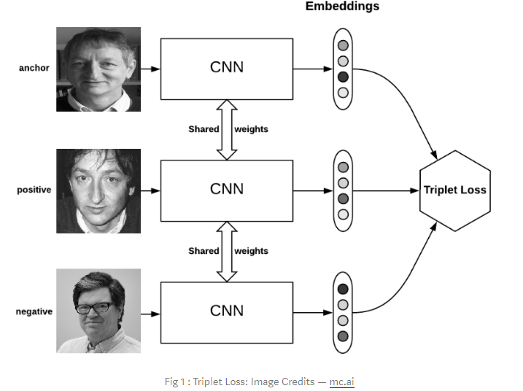

Slide 19
Face Recognition Model
4 Targeted faces and 11 non-targeted faces are pre-processed using MTCNN (Background removal), augmented and resized into 160,160.
As a result, ~10000 images are input into pre-trained Facenet.
With the 128-byte code, it is now a smaller dataset which enables Classifier models to be trained for the final image recognition.
In this project, the objective is to recognize multiple (4) faces. Though Facenet helps to encode the image, it does not serves as final classifier.
Hence, a classifier with 128-byte code as input will have 4 binary/categorical output.
Notes:
[3] FaceNet: A Unified Embedding for Face Recognition and Clustering
Florian Schroff, Dmitry Kalenichenko, James Philbin
(Submitted on 12 Mar 2015 (v1), last revised 17 Jun 2015 (this version, v3))

Slide 20
KNN
KNN is suitable for face recognition.
Cosine distance in between 128-byte code generated from two images (thru Facenet) is a good indicator of image similarity.
KNN can use the cosine distance when defining the nearest neighbor.
As a result, the accuracy can reach 95-97% in the dataset with number of neighbor set to 5.

Slide 21
SVM
SVM is also suitable for face recognition.
Transformation of the 128-byte code enables support vector plane to be found.
With good image preprocessing, facenet usually encodes the image more accurately. This makes SVM training to be feasible using 128-byte code.
SVM usually gives accuracy around 94-96%.

Slide 22
Logistic Regression
Logistic regression is suitable for binary classification using probability function.
After image is encoded into 128-byte code thru Facenet, logistic regression model is built for each targeted face.
Logistic regression is not a linear regression model and so it allow a better binary class prediction using 128-byte code.

Slide 23
Deep Neural Network
While KNN/SVM/Logistic regression gives binary output, deep neural network is able to compute the output in the form of probability.
In this project, the neural network is designed to have 3 stages.
The 1st stage consists of dense layers which accepts 128-byte code generated by the Facenet.
The 2nd stage consists 4 sets of dense layers which also accepts 128-byte code.
At 3rd stages, we have 4 outputs. At each output, it inherits output of each 2nd stage dense layer. It finally concatenates with 1st stage output. After flattening and further dense layers, it will produce softmax output for each targeted face.
As a result, we will avoid weight to be concentrated on 1 of the targeted faces.

Slide 24
Ensemble
Voting ensemble model is used on SVM/KNN/Logistic regression. This is because all the 3 models are having binary outputs.
Voting ensemble output is checked using deep neural network prediction. If the probability is not exceeding 50%, the image is not considered to be recognized.
Since there are 4 targeted face, we will performed voting for each targeted face independently. If an image is recognized to be 2 or more targeted faces, it will not considered to be recognized by the model. This is to prevent cloze ambiguity.

